Slide 1
React Application Architectures with Flux and React
Jon Galloway | Technical Evangelist
Christopher Harrison | Content Developer

Slide 2
Flux

Slide 3
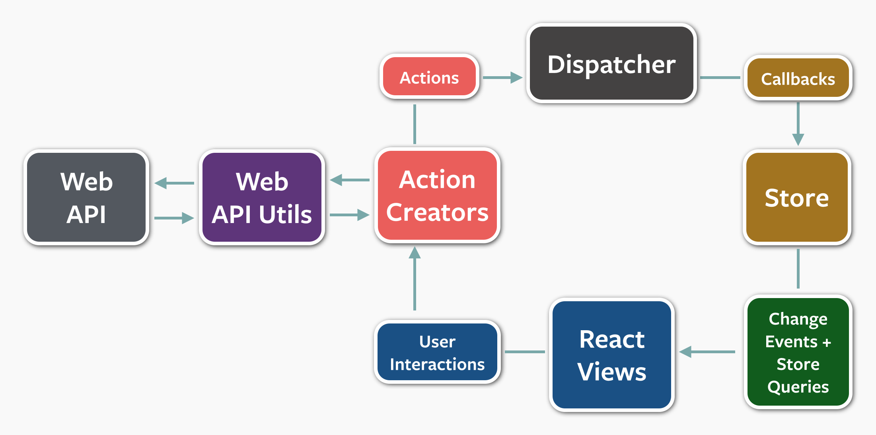

Slide 4
Redux

